Slide 1
Introduction to Julia
A programming language for scientific computing

Slide 2
Content
What is Julia?
Why Julia?
Python vs Julia
What makes Julia fast?

Slide 3
What is Julia?
In a Nutshell:
Julia is a fast programming language, designed from the ground for high performance.
Julia is dynamically typed, it feels like a scripting language and has great support for interactive use.
Julia is reproducible, having a built-in package manager and being available across a wide range of platforms.
Julia is Open Source – under the MIT license.

Slide 4
Why Julia?
High performance – approaches speeds similar to C or Fortran.
Easy to learn – simple syntax similar to MATLAB and Python.
Large ecosystem of packages, particularly for numerical computing, with support for linear algebra built into the language.
Built with support for threading and distributed computing in mind. It is trivial to scale from your laptop to a high performance cluster.
Fast growing language – becoming increasingly popular in numerical computing

Slide 5
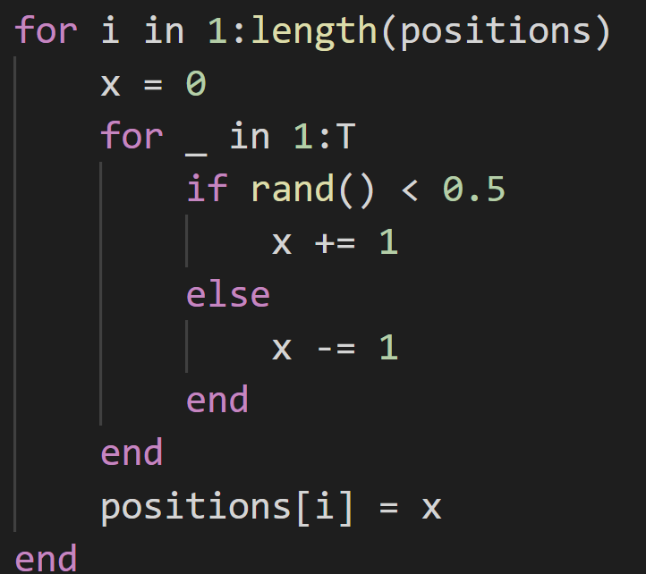
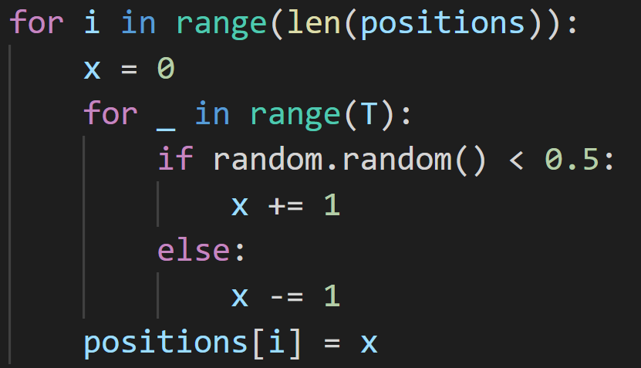

Python vs Julia – Random Walk benchmark
Julia:
Python:
$$N=2^{10}$$
$$T=100$$
10355.7 μs
351.900 μs
Julia is around 30 times faster here

Slide 6
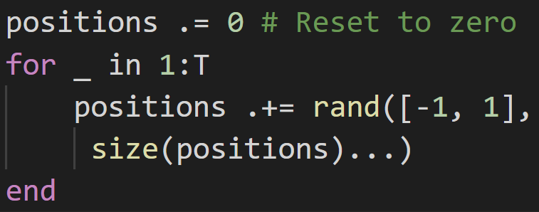
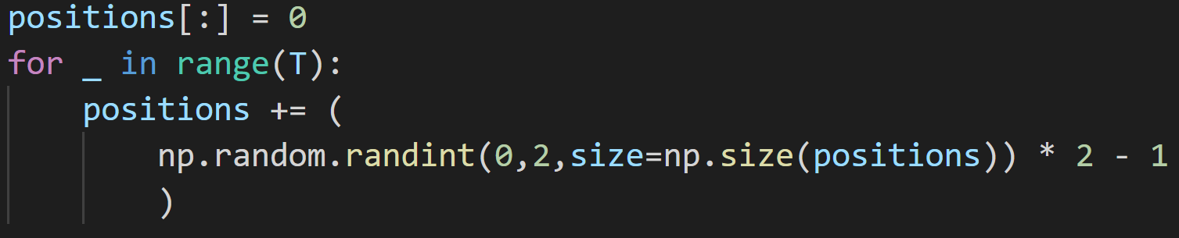

Python vs Julia – Random Walk w/ Arrays
521.900 μs
Julia:
2127.4 μs
Python:
$$N=2^{10}$$
$$T=100$$
Julia is only around 4x faster here, but numpy implementation could be better

Slide 7
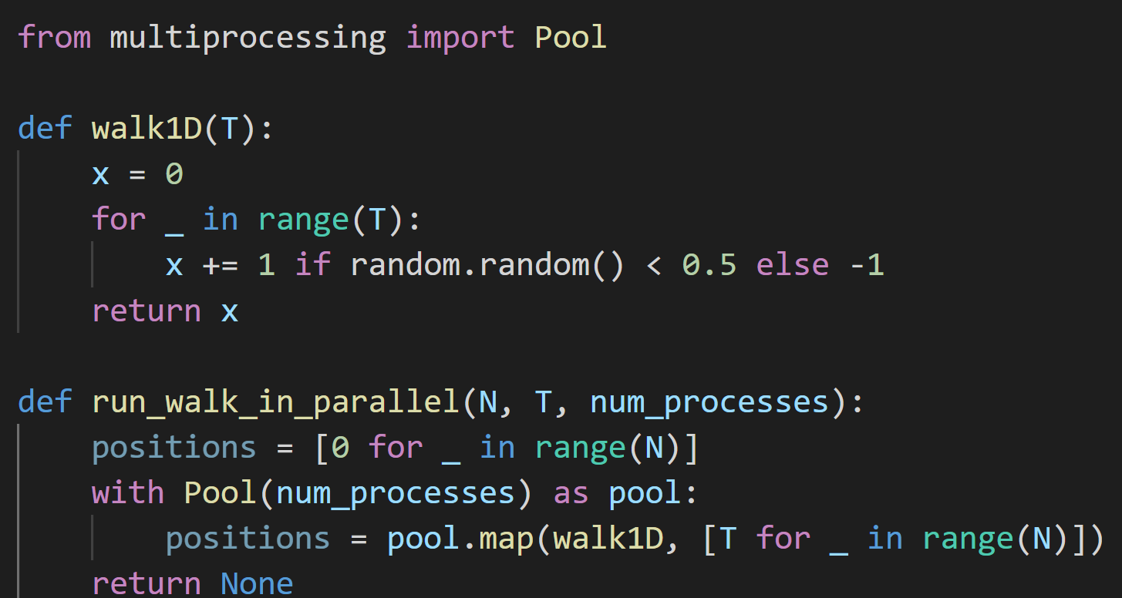

Python vs Julia – Random Walk in Parallel
$$N=2^{20}$$
$$T=100$$
Python:
1030ms

Slide 8
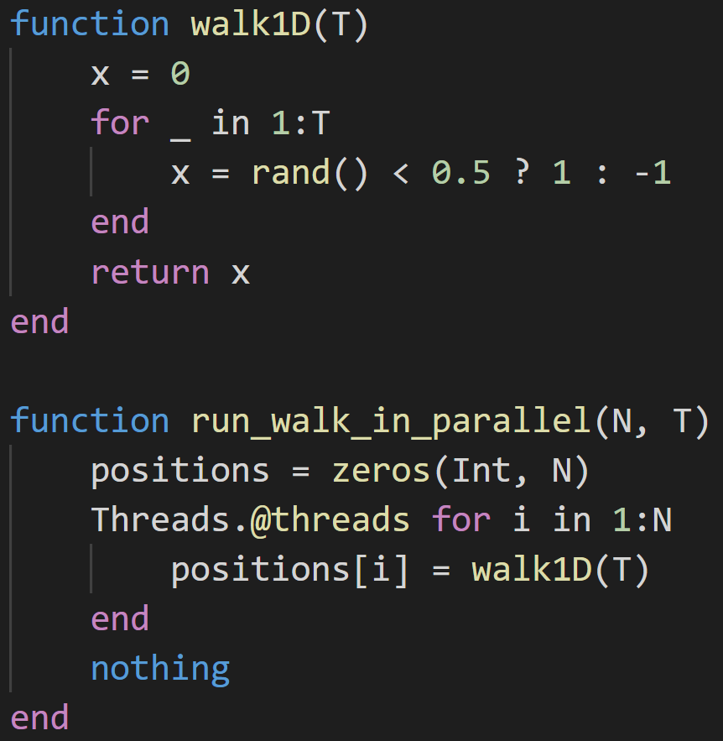
Python vs Julia – Random Walk in Parallel
$$N=2^{20}$$
$$T=100$$
Julia:
~45 times faster than in Python.
22.56ms

Slide 9
What makes Julia fast? – Just-in-Time (JiT) compilation
Allows flexibility of not needing to compile code ahead of time like in C/Fortran, while allowing the code to run quickly once compiled.
Allows the compiler to specialise the machine code produced, since the compiler knows about the types of the arguments.

Slide 10
What makes Julia fast? – Type System

